Slide 1
PQC in X509
IETF 119
16–17 March 2024
Brisbane, Australia

Slide 2
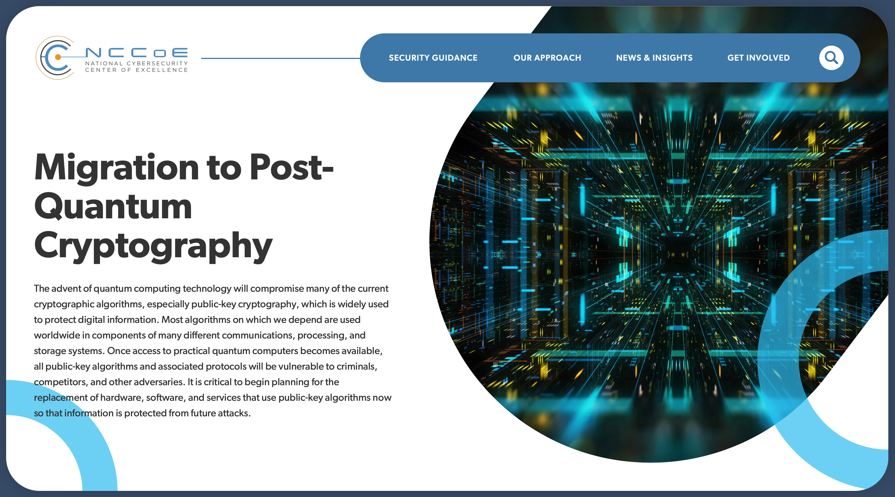
PQC in X.509 interoperability Project
At the IETF 115 Hackathon a group of people got together to start work on testing the interoperability of the new PQ algorithms in keys, signatures and certificates….
This plan continues as we get closer to the final PQ Standards
This project is referenced by the NCCoE
Interoperability and performance workstream

Slide 3
PQC in X.509 interoperability Project
Goals:
Adding PQ algorithm support into existing X.509 structures (keys, signatures, certificates and protocols)
Test interoperability between different algorithm implementations
Gain experience using PQ algorithms
Provide feedback to the standards groups about practical usage
Drafts
draft-ietf-lamps-dilithium-certificates
draft-ietf-lamps-kyber-certificates
draft-bonnell-lamps-chameleon-certs/
draft-ietf-lamps-cms-kemri/
draft-ounsworth-pq-composite-sigs/
draft-ounsworth-pq-composite-kem/
draft-becker-guthrie-cert-binding-for-multi-auth/
draft-lamps-okubo-certdiscovery-00.html
draft-ounsworth-lamps-pq-external-pubkeys/
draft-ietf-lamps-rfc4210bis
draft-fluhrer-cfrg-ntru
draft-ounsworth-cfrg-kem-combiners

Slide 4
What GOT DONE
Updated testing to support the NIST drafts ML-DSA (FIPS 204), ML-SLH (FIPS 205) and ML-KEM (FIPS 203) specifications
We now have 4 unique algorithm implementations for MLDSA defined and a few Kyber implementations.
New artifact formats defined for expanded testing:
New certificate “R3” .zip file format defined to simplify testing certs.
New CMS based artifact format defined to simplify KEM testing
CryptoNext, Rust and Bouncy Castle interop testing happening
NTRU artifacts added during this hackathon!
CMP artifact formats defined to simplify CMP testing
Keeping the OID mapping table to align with the NIST draft release

Slide 5
What GOT DONE
Composite KEM implementation is being developed
Numerous implementations of Composite Signatures v13
BC, Entrust, CryptoNext, Digicert, OpenSSL, others
Multi-auth for certificate binding artifacts being developed
Discussions about how the multi-auth binding and discovery drafts can be complimentary
Interest in working on other new PQ Migration mechanisms
Chameleon certs, related keys and cert discovery

Slide 6
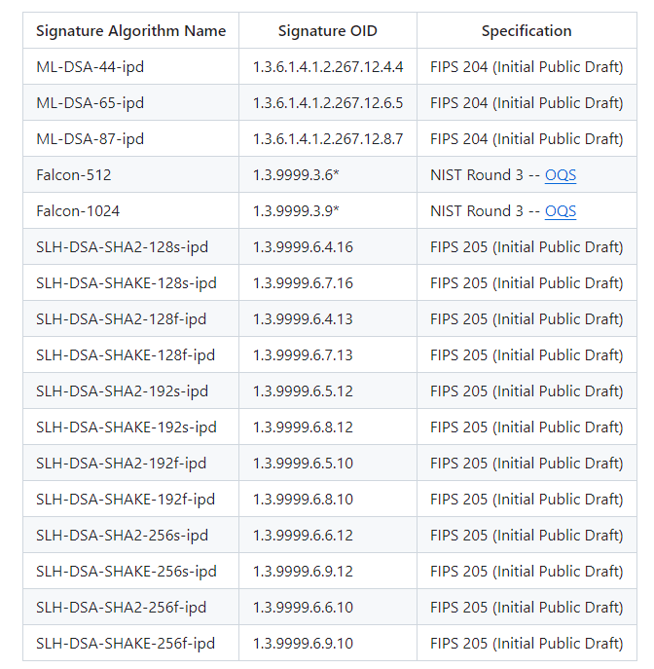
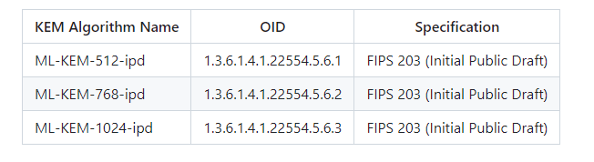
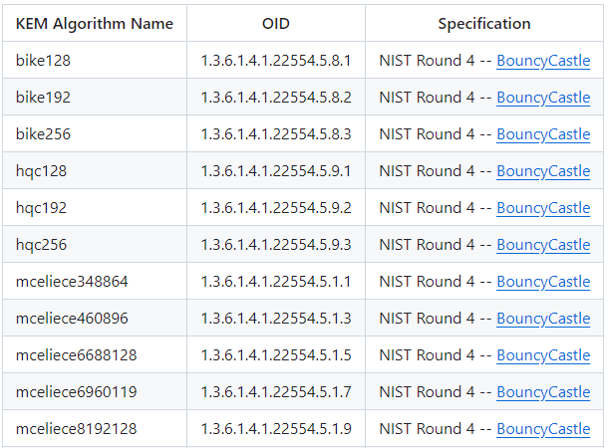
INTEROPERABLE OID Mapping Table

Slide 7
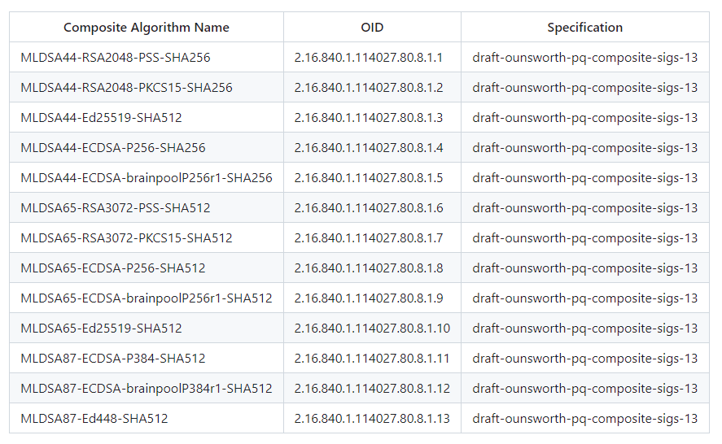
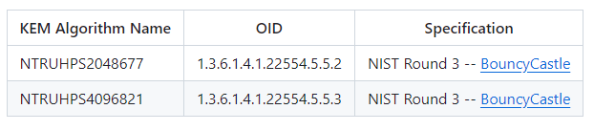
INTEROPERABLE OID Mapping Table

Slide 8
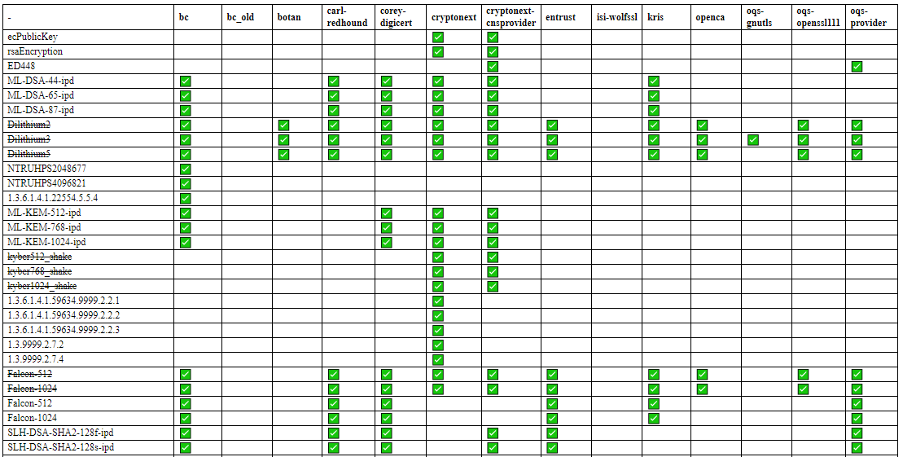
Compatibility matrix Sample
….

Slide 9
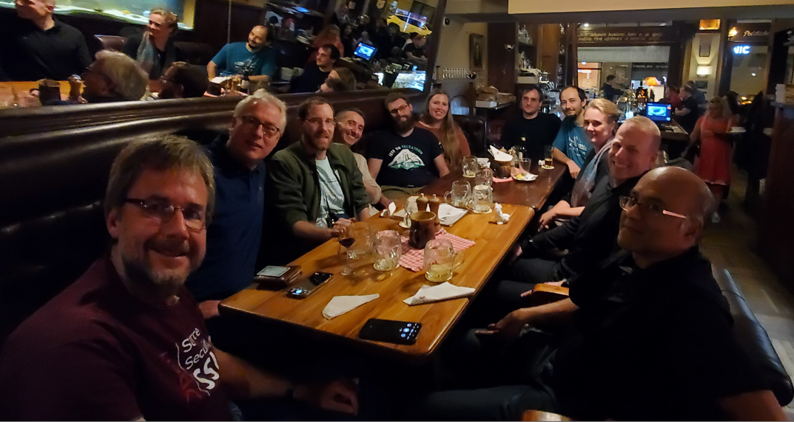
PQ in X.509 – Summary
TEAM MEMBERS
Michael Baentsch, Alie Becker, Cory Bonnell, Chris Brown, John Gray, Britta Halle, David Hook, Pat Kelsey , Kris Kwiatkowski, Jake Massimo, Tomofumi Okubo, Markku-Juhani O.Saarinen, Mike Ounsworth, Max Pala, Julien Prat, Alexander Railean, Chris Rodine , Goutam Tamvada, George Tasopoulos , Daiki Ueno, Felipe Ventura, Carl Wallace, Brendan Zember, others
FIRST TIMERS
Ned Smith, Akira Nagai, Kan Yasuda, Yuta Fukagawa, Joe Mandel
NEXT STEPS
Monthly meetings to continue progress – Next meeting is Tuesday April 2nd
Virtual Interim Hackathon (End of May?)
Compatibility Matrix updates
Github: https://github.com/IETF-Hackathon/pqc-certificates

Slide 10
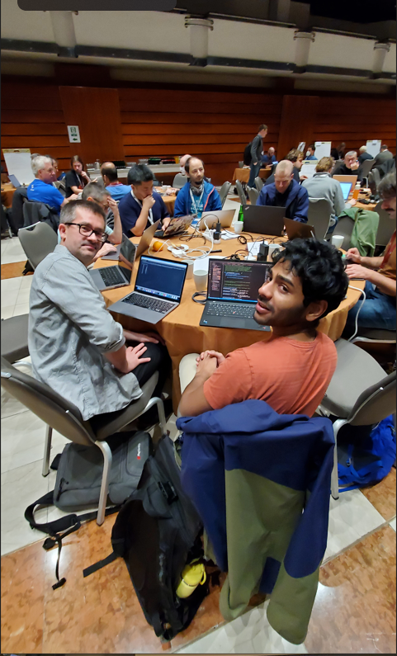
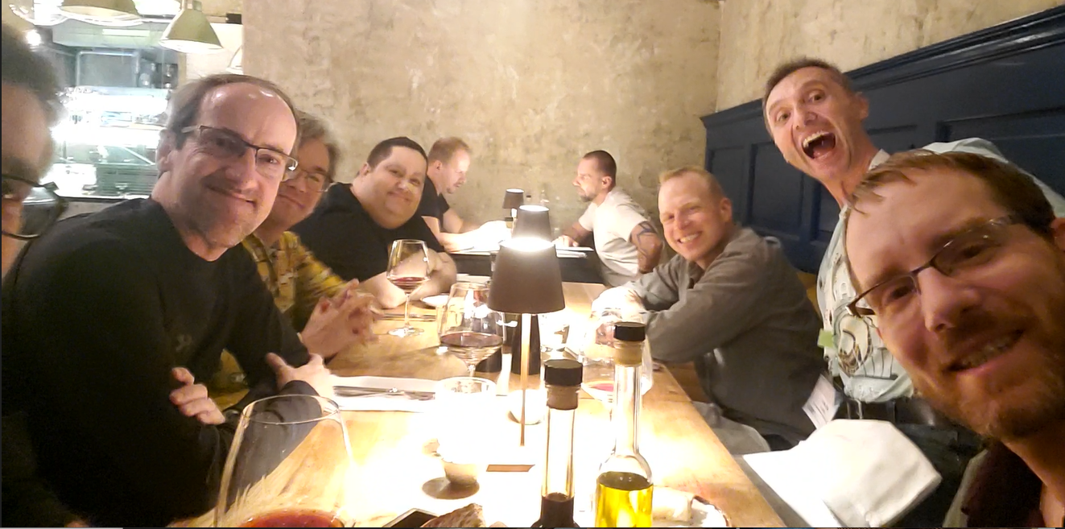
JOIN US!
Contact John.gray@entrust.com to join!

